Slide 1
NHS General practitioner appointments
analysis
Ang Jia Shin

Slide 2
Cost to NHS
The NHS incurs significant, potentially avoidable, costs when patients miss general practitioner (GP) appointments. Therefore, reducing or eliminating missed appointments would be the top priority for NHS. This would be beneficial to everyone, financially as well as socially.

Slide 3

Analysis points
Investigate Capacity of the medical networks and staff involved and actual utilisation of resources and factors affecting missed appointments.
Provide Recommendations to remedy the issues of missed appointments.

Slide 4
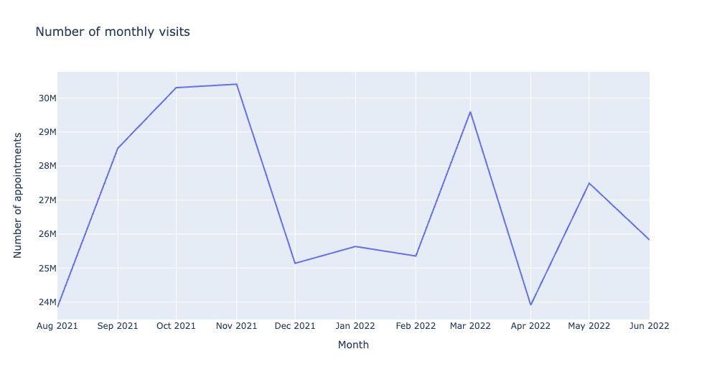
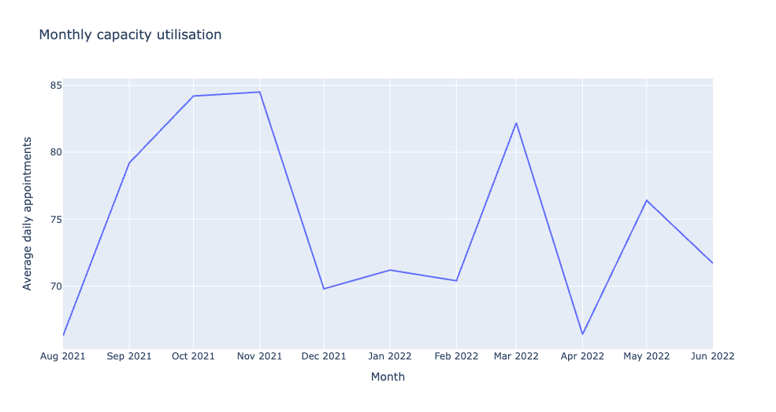
Monthly appointments and capacity utilisation

Slide 5
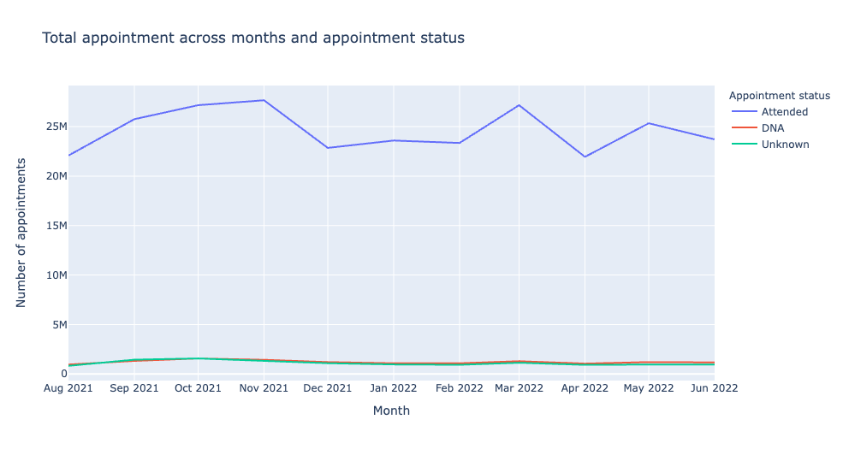
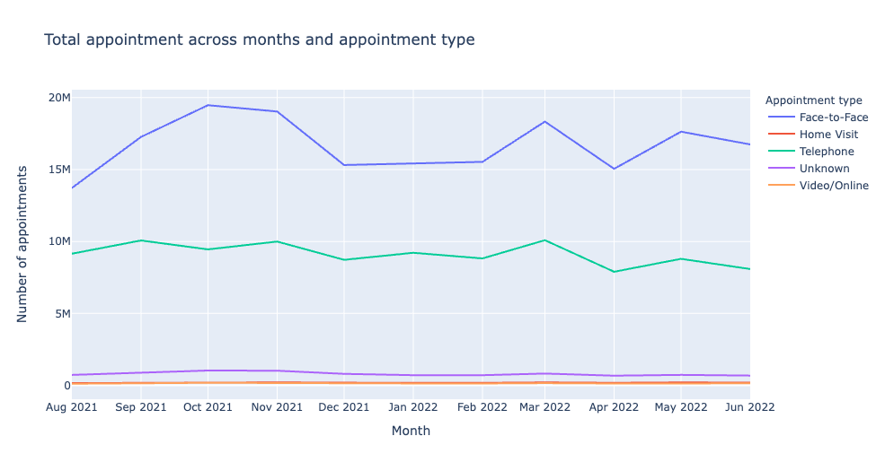
Appointment status and type

Slide 6
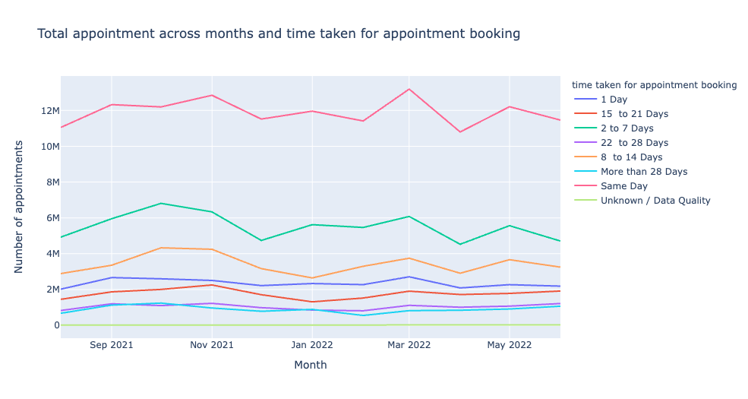
Time taken for appointment bookings

Slide 7
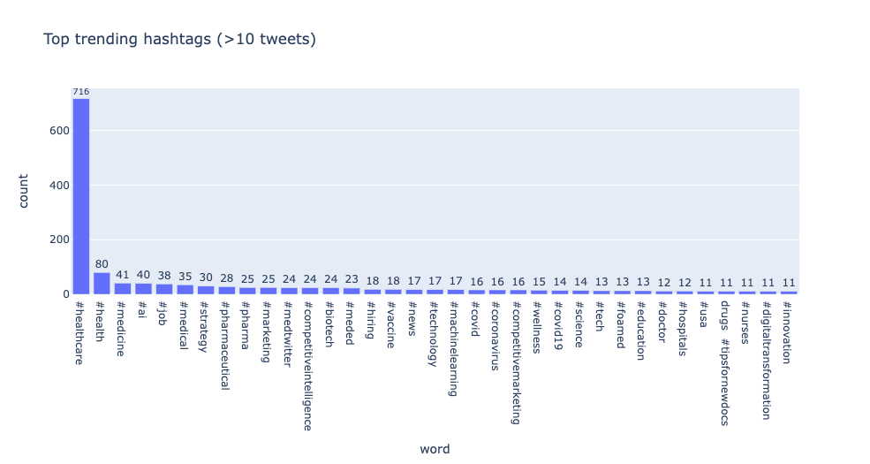

Slide 8
What were the proportions of appointments related to General practice?

Slide 9
For the month of August 2021
50% national category appointments
90% care related encounters appointments
90% of service setting related general practice.

Slide 10
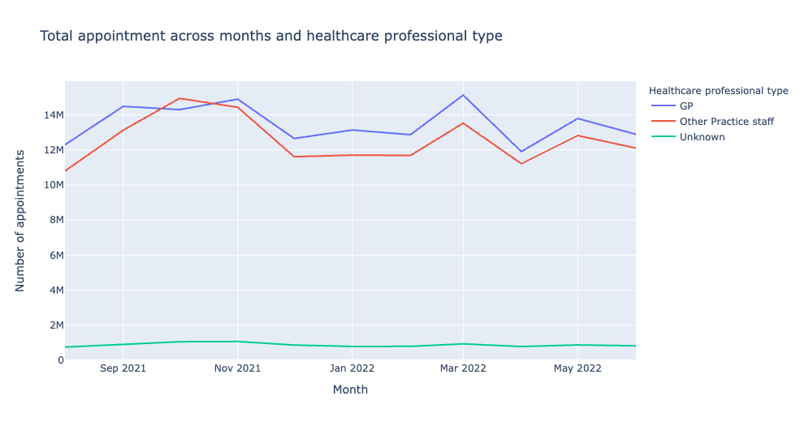
Healthcare professional type

Slide 11
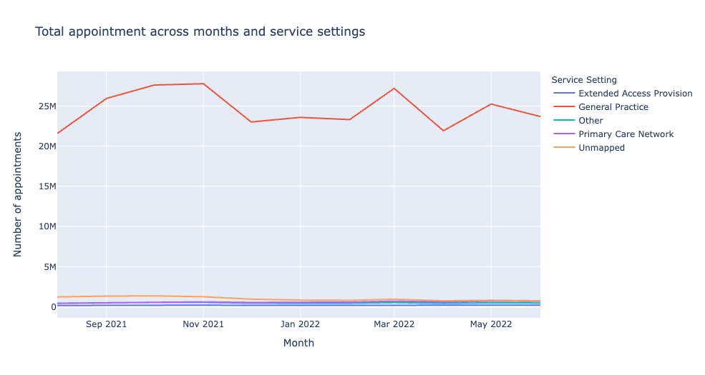
Healthcare professional type

Slide 12
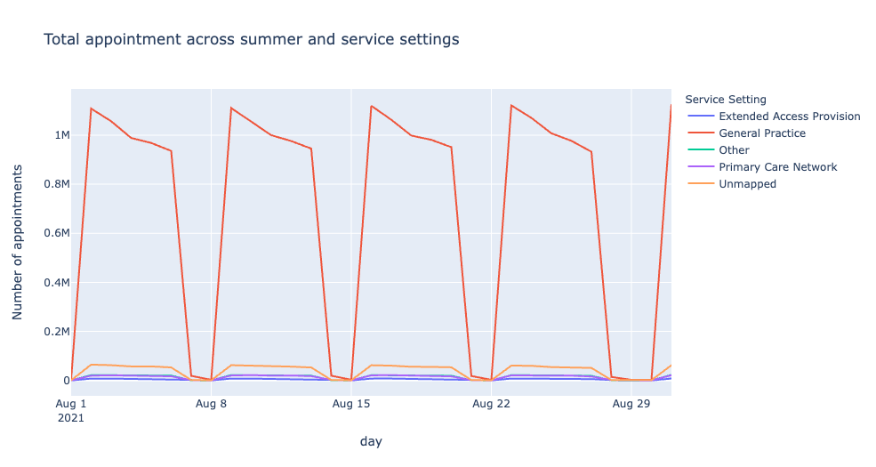
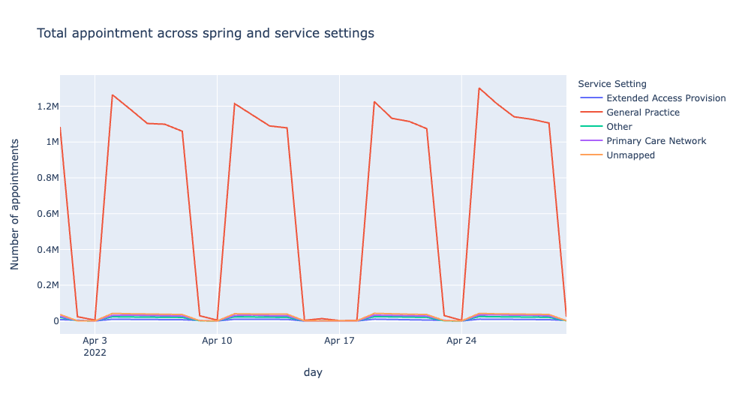

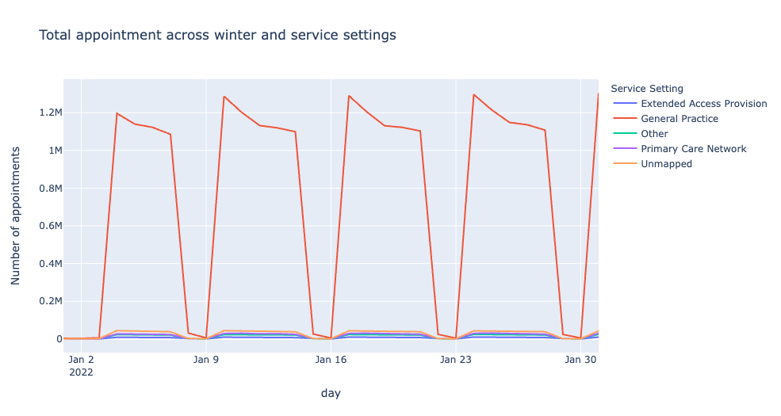
Across seasons

Slide 13
Recommendations
Reallocate staff on weekends to weekdays
Alleviate strains on weekdays.
Promote teleconsultation
Reduce wait time, direct access to different service settings, no interactions
Leverage on Social media platform to send news to the masses
Instant impact, raise awareness.

Slide 14
Conclusion
Missing medical appointments delays treatment for other patients in need, creates stress on the medical staff and capacity and ultimately increases mortality rate.
Through the recommendations, decrease the number of missed attendance, reduce costs to everyone, and ultimately, save more lives.

